Slide 1
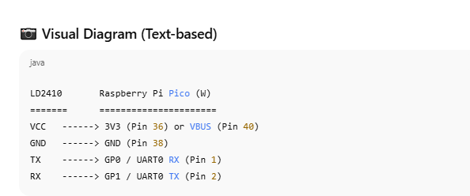
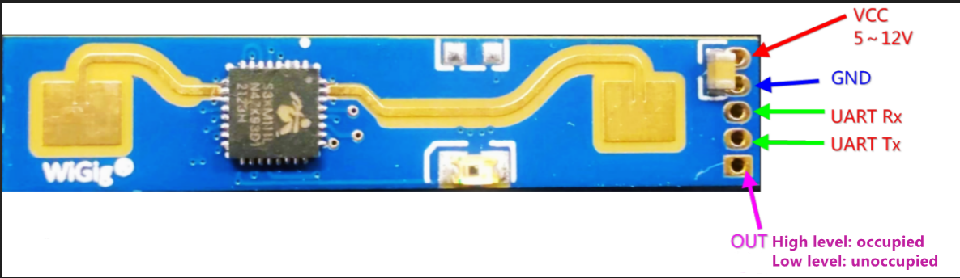
VBUS
GPIO 21
UART
1
GPIO 20

Slide 2
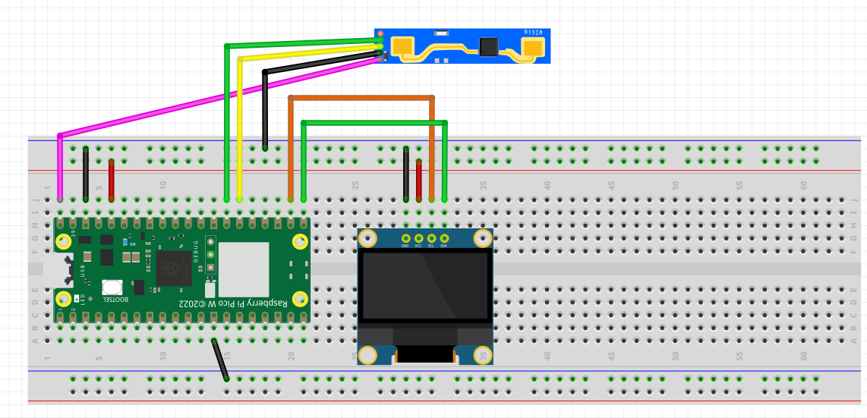
Wiring Diagram for LD2410 with OLED Display
NC
TX
RX
GN
VB
VBUS
GND
VCC
SCL
SDA
<<-Check!! Your Pin Position may be different

Slide 3
ld2410_presence.py
By chatGPT 5

Slide 4
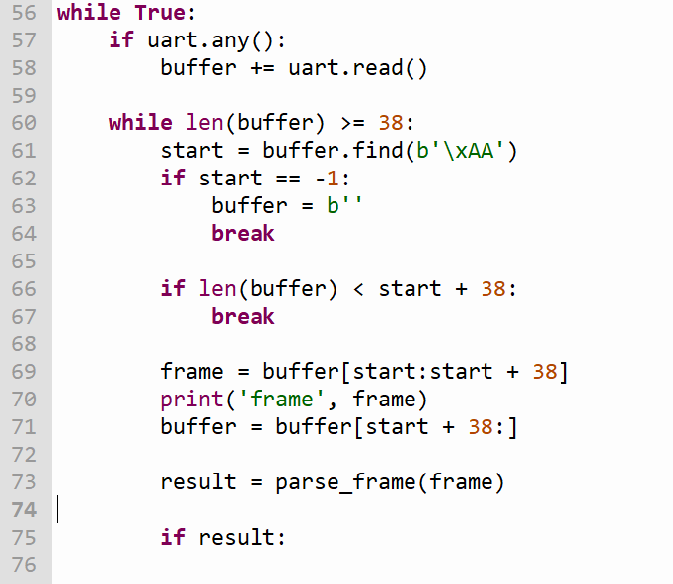
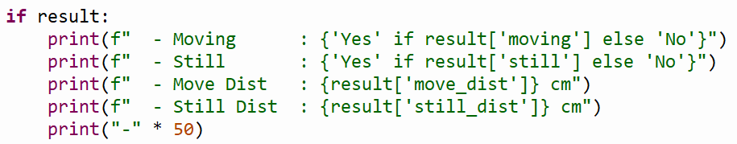

frame
b'\xaa\x03\x1e\x00:\x1e\x00d\x00\x00U\x00\xf8\xf7\xf6\xf5\xf4\xf3\xf2\xf1\r\x00\x02\xaa\x03\x1e\x00:\x1e\x00d\x00\x00U\x00\xf8\xf7\xf6'
{'still_dist': 30, 'moving': True, 'move_dist': 30, 'still': True}

Slide 5
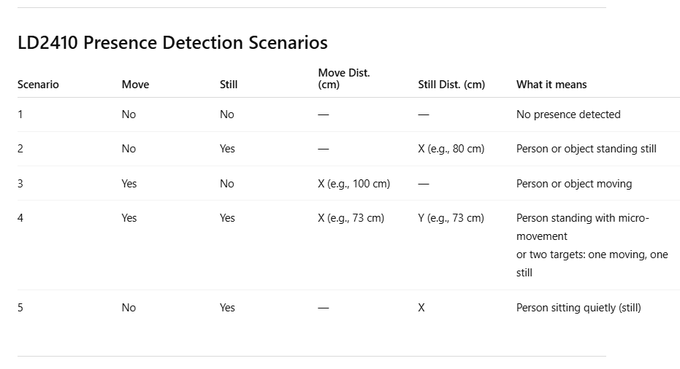

Slide 6
